Slide 1


MVSR ENGINEERING COLLEGE, HYDERABAD - 501 510
Department of Computer Science and Engineering
BLOOD CELLS DETECTION
Batch No: C24
K.BHARATH – 2451-17-733-335
K.NITHISH – 2451-17-733-329
G.SANDEEP – 2451-17-733-326
Under the guidance of
A.SARITHA
(ASSISTANT PROFESSOR),CSED

Slide 2
Batch : C24 Tittle : Blood Cells Detection
PROBLEM STATEMENT:
Deep learning based models have had great success in object detection, but the state of the art models have not yet been widely applied to biological image data. We apply for an object detection model previously used on natural images to identify cells and recognize their stages in bright field microscopy images of malaria-infected blood
Applying Faster R-CNN for Object Detection on Malaria Images.
PROJECT SCOPE:
Many micro-organisms like malaria parasites are still studied by expert manual inspection and hand counting. This type of object detection task is challenging due to factors like variations in cell shape, density, and color, and uncertainty of some cell classes.
Given images of blood samples predict whether a patient has malaria or not ?

Slide 3
Batch : C24 Tittle : Blood Cells Detection
APPLICATION AREAS:
Medical Sector
CHALLENGES:
We use Faster Region-based Convolutional Neural Network (Faster R-CNN), one of the top performing object detection models in recent years, pre-trained on ImageNet but fine tuned with our data, and compare it to a baseline, which is based on a traditional approach consisting of cell segmentation, extraction of several single-cell features, and classification using random forests.

Slide 4
Batch : C24 Tittle : Blood Cells Detection
SOFTWARE/HARDWARE REQUIREMENTS:
Operating System : Windows 7 or higher
Front end : Python (anaconda 3)
Package : numpy, Pandas, keras, matplotlib, sklearn, tensorflow, Object_detection
OBJECTIVES:
Applying Faster R-CNN for Object Detection on Malaria Images
Sample image of Infected Blood Cells

Slide 5
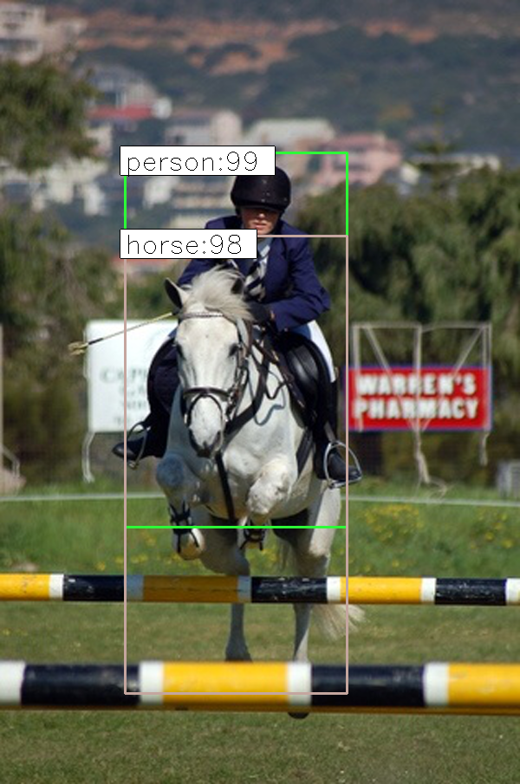
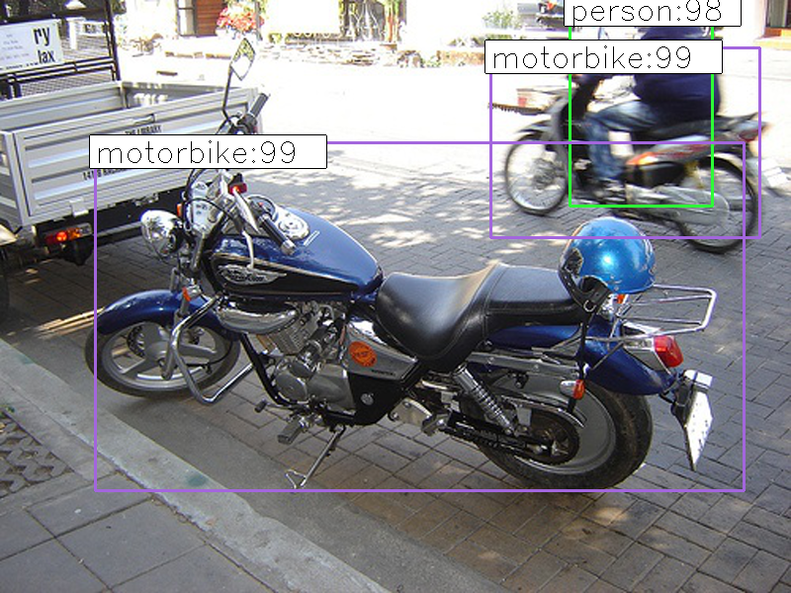
Batch : C24 Tittle : Blood Cells Detection
Module-1 Description:
Faster R-CNN
It is similar to the R-CNN approach but the only difference here is the induction of convolutional feature map that is used to detect the regions in an image
to reshape them into a bounding box.
It profoundly replaces the Selective Search technique with much efficient Region Proposal Network that generates the detected areas in an image.
It is highly used for carrying out real-time performance-based tasks in object detection tasks. It provides a trade-off between accuracy and speed.
Faster R-CNN was the first to include the anchor boxes. It also carries out processes like testing and training way faster than R-CNN.
Inputs: Outputs:
Faster R-CNN
Inputs: images, bounding box, labels
Output: bounding box, probability
Marks:2

Slide 6
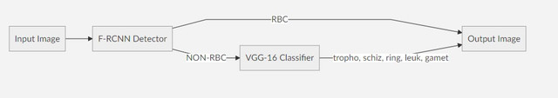
Batch : C24 Tittle : Blood Cells Detection
Two Stage Detection and Classification
First Stage
Label all the cells other than RBC as Non RBC cells and then create a object detector that only detects either cell is RBC or NON RBC. For this task I used Tensorflow Object Detection API to fine-tune and train a Faster RCNN model pre-trained on coco dataset.
Second Stage
For all the NON RBC cells create a CNN Classifier to classify given a NON RBC cell which category it belongs (trophozoite, schizont, ring, leukocyte, gametocyte). I fine-tuned VGG-16 Model trained on imagenet data.

Slide 7
Batch : C24 Tittle : Blood Cells Detection
Faster R-CNN Architecture

Slide 8

VGG16 ARCHITECHTURE
Batch : C24 Tittle : Blood Cells Detection

Slide 9
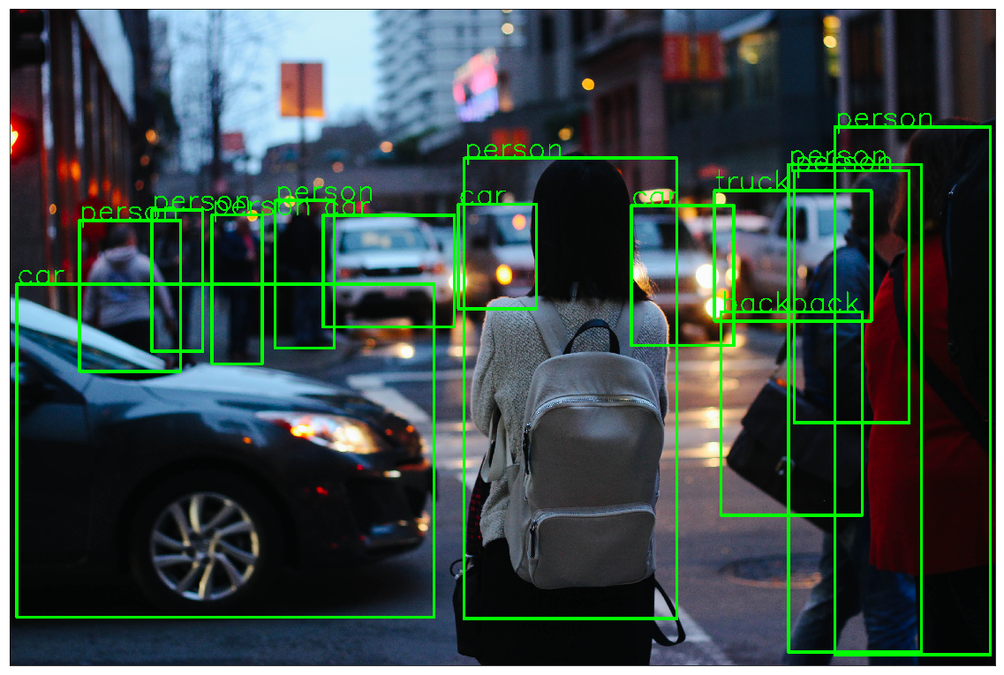
Batch No: C24 Name of the project: BLOOD CELLS DETECTION
Software Environment Used : Jupyter Notebook, Anaconda Major Functions used : Tensorflow object detection API and Transfer Language. Number of lines of code :42
Test cases for Module 1:
Scenario 1:
Test case 1:
Input : images, bounding box, labels Output : After Detection Image

Slide 10
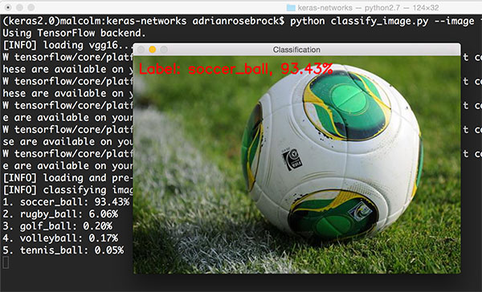
Batch No: C24 Name of the project: BLOOD CELLS DETECTION
Software Environment Used : Jupyter Notebook, Anaconda Major Functions used : VGG 16 Classifier Number of lines of code : 28
Scenario 1:
Test case 1:
Input : Ball Image Output : Soccer ball Image

Slide 11
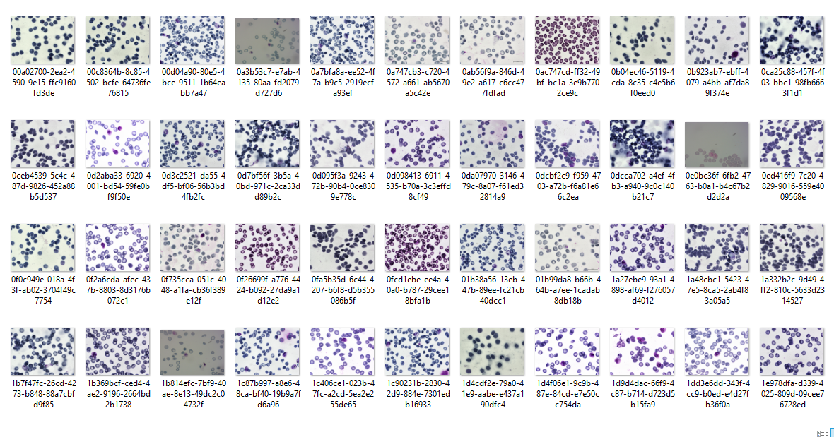
Batch : C24 Tittle : Blood Cells Detection
DATASET EMPLOYED :
The dataset consists of 1328 blood cells image which consists of overall (100,000 cells ) and
corresponding information, which indicate different state of malaria infection including "red blood cell", "difficult", "gametocyte", "trophozoite", "ring", "schizont" and "leukocyte". Each image(.png) includes
several such cells and is labeled by a text file(.txt) and a bounding box (.json).
EVALUATION METRICS: Accuracy,
mAp.
Marks:2

Slide 12
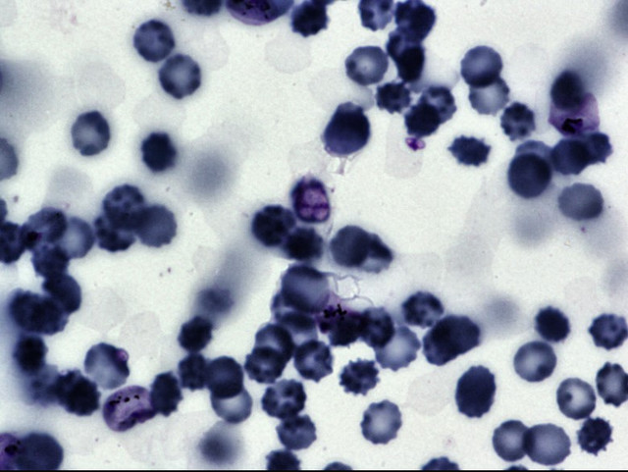
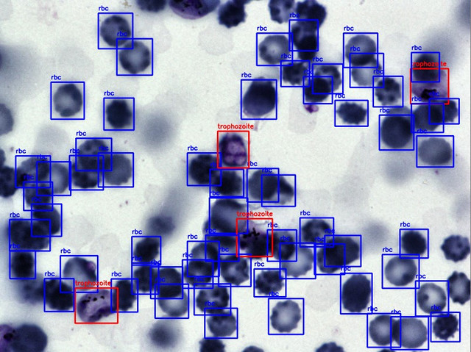
Batch No: C24 Name of the project: BLOOD CELLS DETECTION
RESULTS

Slide 13
Batch No: C24 Name of the project: BLOOD CELLS DETECTION
CONCLUSION
The classification and detection RBCs and WBCs of aiding the medical field makes fast and reliable system
The faster RCNN is not only compatible but also reliable to be employed for the pretrained data set
FUTURE SCOPE
Based from existing related literature, ordinary Neural Networks are usually employed. Also, in existing researches, RBC types are the main focus.
The aim is to have a fast and reliable system in order to achieve the goal of aiding the medical field in the classification of RBCs and WBCs.

Slide 14
Batch No: C24 Name of the project: BLOOD CELLS DETECTION
REFERENCES
[1] V. Acharya and P. Kumar, “Identification and red blood cell classification using computer aided system to diagnose blood disorders,” 2017 Int. Conf. Adv. Comput. Commun. Informatics, ICACCI 2017, vol. 2017-January, pp. 2098–2104, 2017.
[2] R. J. Meimban, A. R. Fernando, A. Monsura, J. Ranada, and J. C. Apduhan, “Blood Cells Counting using Python OpenCV,” Int. Conf. Signal Process. Proceedings, ICSP, vol. 2018-Augus, pp. 50–53, 2019.
[3] S. Ren, K. He, R. Girshick, and J. Sun, “Faster R-CNN: Towards Real-Time Object Detection with Region Proposal Networks,” in NIPS, 2015.
[4] R. Girshick, “Fast R-CNN,” in IEEE International Conference on Computer Vision (ICCV), 2015.
[5] J. Gatc and F. Maspiyanti, “Red blood cell and white blood cell classification using double thresholding and BLOB analysis,” 2016 4th Int. Conf. Inf. Commun. Technol. ICoICT 2016, vol. 4, no. c, pp. 1–5, 2016.
[6] S. Tantikitti, S. Tumswadi, and W. Premchaiswadi, “Image processing for detection of dengue virus based on WBC classification and decision tree,” Int. Conf. ICT Knowl. Eng., vol. 2015-Decem, pp. 84–89, 2015.

Slide 15
THANK YOU

